Slide 1
Vectorization – Part 2

Slide 2
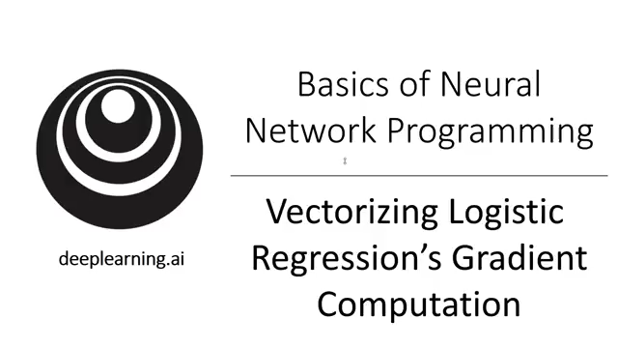
Vectorizing Logistic Regression Gradient Descent

Slide 3
Vectorizing Logistic Regression

Slide 4
Implementing Logistic Regression
J = 0, d$w_{1}$ = 0, d$w_{2}$ = 0, db = 0
for i = 1 to m:
$z^{(i)}$ = $w^{T}x^{(i)}+b$
$a^{(i)}$ = $σ{(z}^{(i)})$
$J$+= $−\left[y^{(i)} \log{a^{\left(i\right)}+({1−y}^{\left(i\right)})\log{(1 −a^{\left(i\right)})}}\right]$
d$z^{(i)}$ = $a^{(i)}{−y}^{(i)}$
d${w_{1}}^{ }$+= $x_{1}^{(i)}\text{d}z^{(i)}$
d${w_{2}}^{ }$+= $x_{2}^{(i)}\text{d}z^{(i)}$
db += d$z^{(i)}$
J = J/m, d$w_{1}$ = d$w_{1}$/m, d$w_{2}$ = d$w_{2}$/m
db = db/m

Slide 5

Broadcasting in Python

Slide 6
Broadcasting example
Calories from Carbs, Proteins, Fats in 100g of different foods:
Apples
Beef
Eggs
Potatoes
Carb
$$\left[\begin{matrix}56.0 & 0.0 & \begin{matrix}4.4 & 68.0\end{matrix} \\ 1.2 & 104.0 & \begin{matrix}52.0 & 8.0\end{matrix} \\ 1.8 & 135.0 & \begin{matrix}99.0 & 0.9\end{matrix}\end{matrix}\right]$$
Protein
Fat
cal = A.sum(axis = 0)
percentage = 100*A/(cal.reshape(1,4))

Slide 7
Broadcasting example
$$\left[\begin{matrix}1 \\ \begin{aligned}\begin{matrix}2 \\ 3\end{matrix} \\ 4\end{aligned}\end{matrix}\right]$$
$$\left[\begin{matrix}101 \\ \begin{aligned}\begin{matrix}102 \\ 103\end{matrix} \\ 104\end{aligned}\end{matrix}\right]$$
$$100$$
=
+
$\left[\begin{matrix}1 & 2 & 3 \\ 4 & 5 & 6\end{matrix}\right]$
$$\left[\begin{matrix}100 & 200 & 300\end{matrix}\right]$$
$$\left[\begin{matrix}101 & 202 & 303 \\ 104 & 205 & 306\end{matrix}\right]$$
+
=
$\left[\begin{matrix}1 & 2 & 3 \\ 4 & 5 & 6\end{matrix}\right]$
$$\left[\begin{matrix}100 \\ 200\end{matrix}\right]$$
$$\left[\begin{matrix}101 & 102 & 103 \\ 204 & 205 & 206\end{matrix}\right]$$
+
=

Slide 8
General Principle

Slide 9

NumPy

